Slide 1
Last Week
Decision trees (DT) are easy to understand, easy to interpret ML models used for classification and for regression
DT algorithm recursively split data into pure subsets
Purity is measured based on 2 criterion:
Entropy
Gini
Problems with DT
Overfitting
Sensitive to data change

Slide 2
RANDOM FOREST
An introduction to ensemble learning

Slide 3
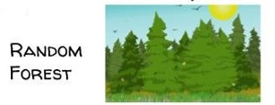
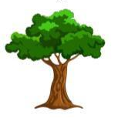
What is Random Forest?
A supervised machine learning method
A RF is built as an ensemble of decision trees
Decision Tree
Decision Tree
Decision Tree
Decision Tree
Decision Tree

Slide 4
Is one decision tree not sufficient?
A decision tree is not as performant as other ML models (Linear regression, logistic regression, …)
If not constrained and regularized properly, a tree has high risk of
Overfitting: A fully grown tree may lose some generalization capability
Becoming computationally complex

Slide 5
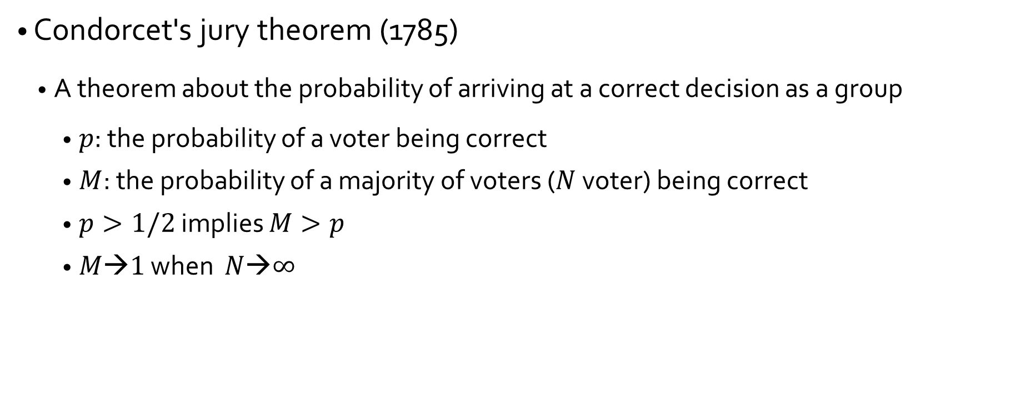
Why multiple trees?

Slide 6
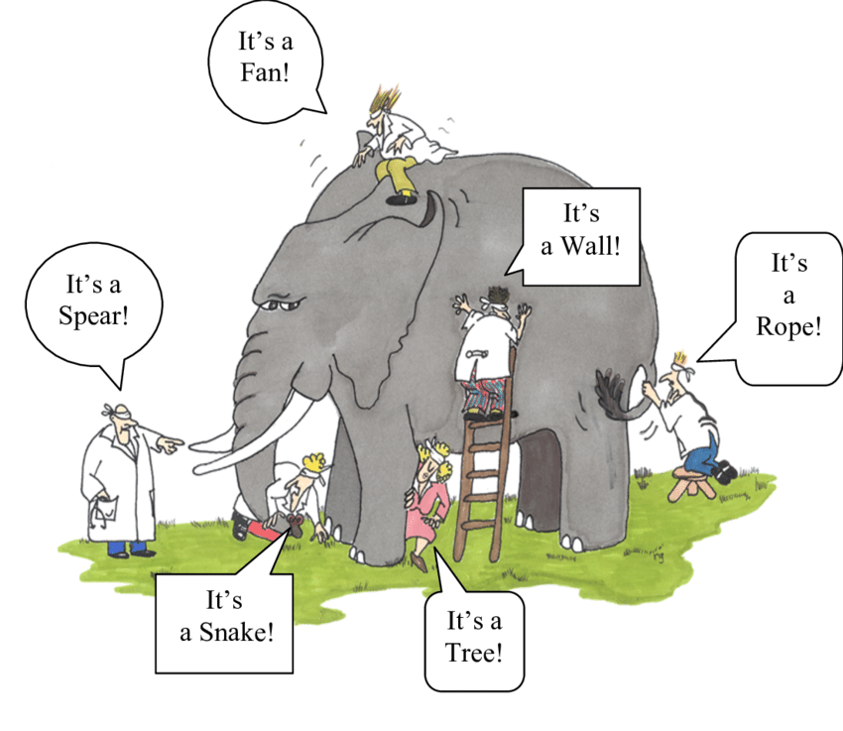
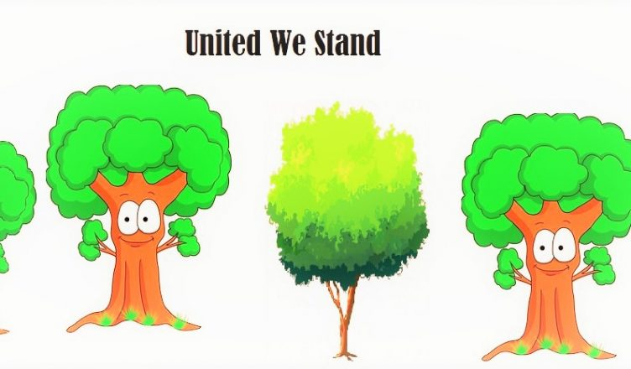
Why multiple trees?
The wisdom of the crowd
The Blind Men and the Elephant

Slide 7
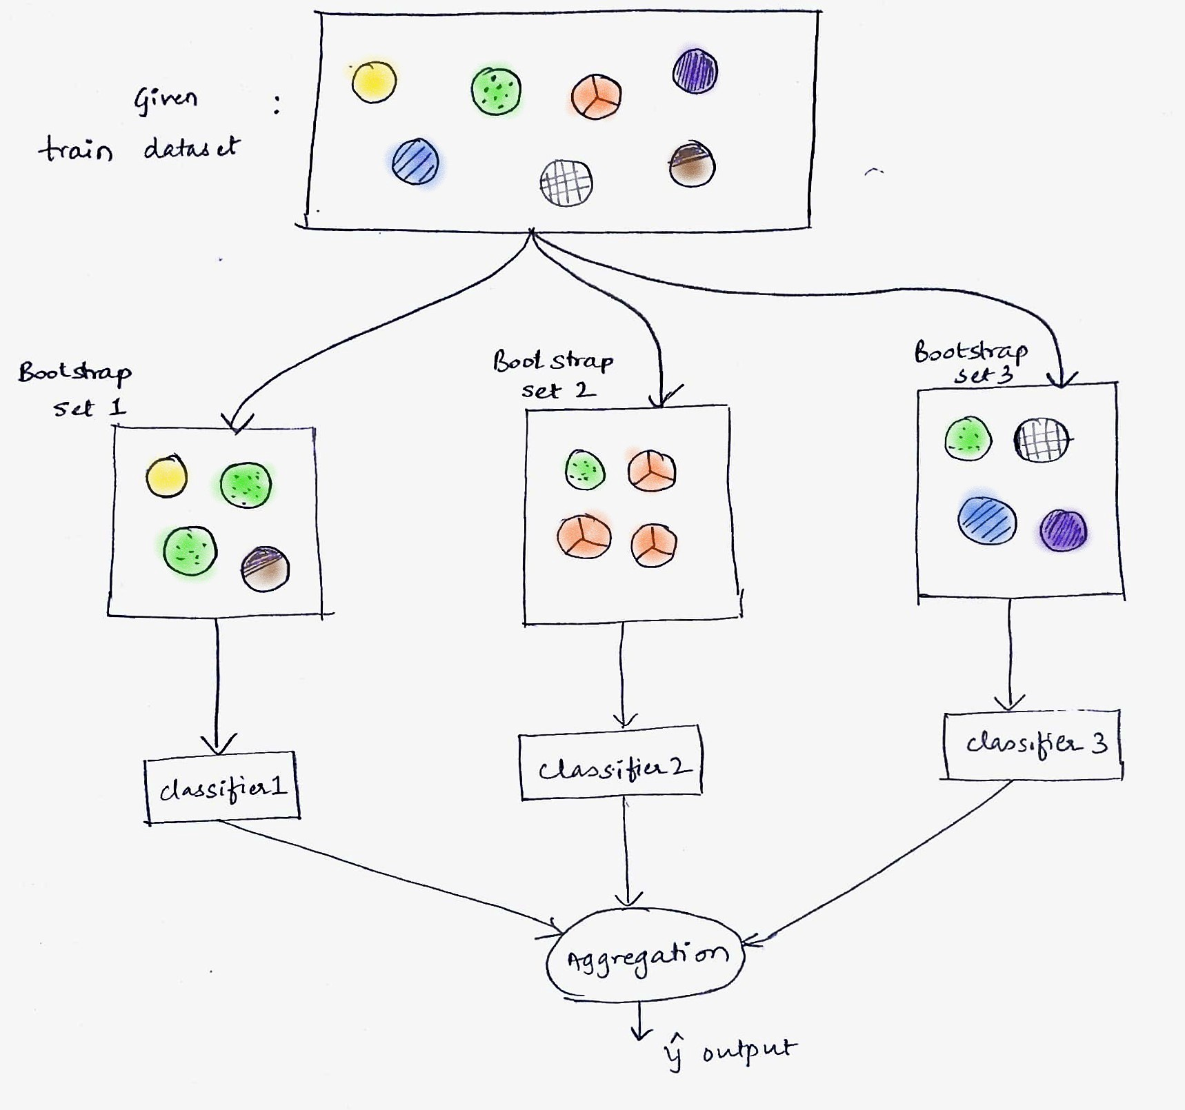
How to build a Forest?
Tree Bagging:
Bagging = Bootstrap aggregating
3 steps:
Bootstrap sampling: Sample subsets of the training set (with replacement)
Train a decision tree on each subset
Aggregating: Aggregate the results

Slide 8
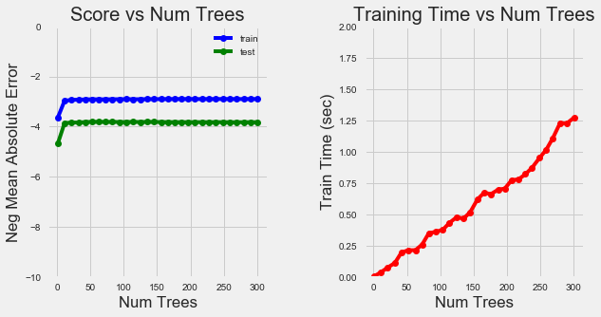
How to build a Forest?
Tree Bagging:
How to choose the number of trees?
Depends on the training set
A tunable parameter
The optimal number can be found using validation techniques:
Cross-validation
Out-of-bag error

Slide 9
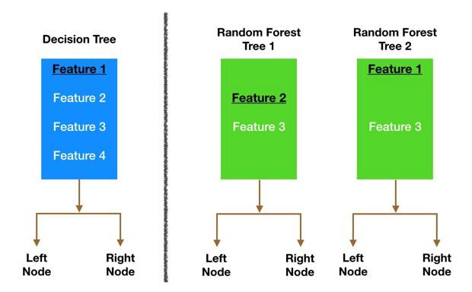
How to build a Random Forest?
Tree Bagging + Feature Bagging:
Use random subset of features for each tree
A tunable parameter
Typically, given p features
sqrt(p) for classification problems
p/3 for regression problems

Slide 10
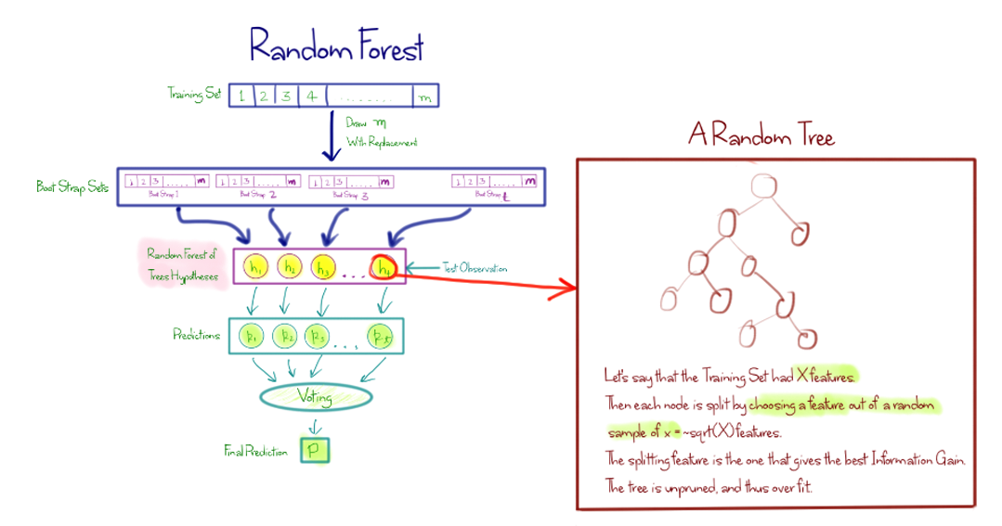
How to build a Random Forest?

Slide 11
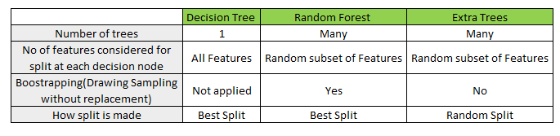
Extremely randomized trees (a.k.a Extra trees)
A variant of Random Forests
Same process but more randomness
Random split instead of best splitting
Trees are trained using the whole training set

Slide 12
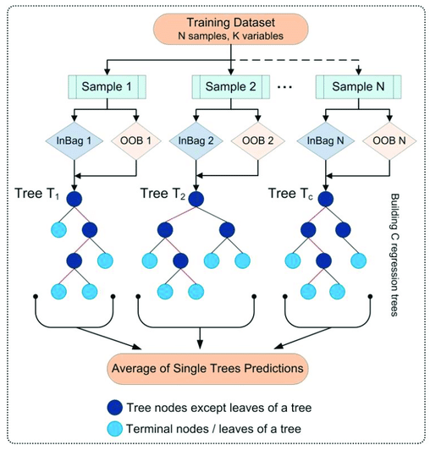
Out-Of-Bag Error (OOB)
OOB score is one way for RF model validation
Almost identical to N-fold cross validation
Out-Of-Bag samples are the samples that were not used in training
OOB score is computed as the number of correctly predicted rows from the out of bag sample.
A good trade-off for small datasets

Slide 13
Variable importance
Model interpretability can be recovered through variable importance
RF are a popular approach for feature selection
Two possible methods for measuring importance:
Mean Decrease Impurity (MDI): Gini/entropy based
Variable importance obtained by summing total impurity reductions across all tree nodes where the variable appears.
Mean Decrease Accuracy (MDA): Permutation based
Variable importance obtained by measuring accuracy reduction on out-of-bag samples after shuffling the variable values

Slide 14
In summary
Random Forest makes predictions by combining the results from many individual decision trees.
Random Forest held the same strength of decision trees
Unlike trees, Random Forest is less prone to overfitting
RF gain in model robustness is lost in interpretability.
Because RF combines multiple models, it falls under the category of ensemble learning.

